Slide 1
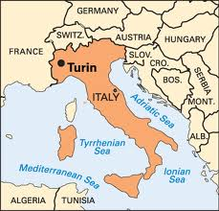
Turin/Torino
By: Samuel Hernandez

Slide 2
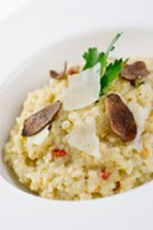
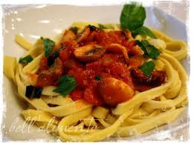
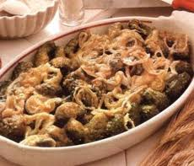
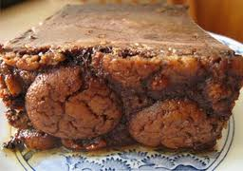
Food
Risotto-ham, mushrooms, onion, vegetables and rice.
Tagliatelle-egg noodles cut in long, flat pieces.
Cabiette-raw potatoes, onions, pumpernickel, nettle, light cheese and eggs.
Bonet-made with amaretti, cocoa, eggs, cream and caramel.

Slide 3
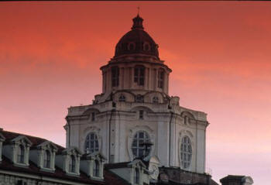
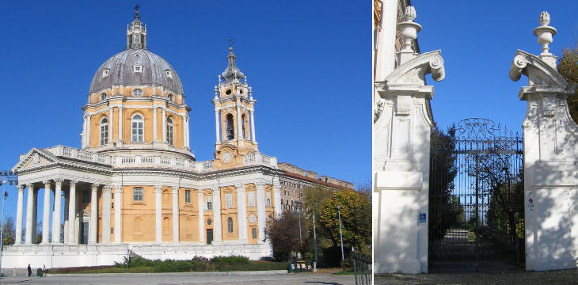
Historical Landmarks
San Lorenzo- 1666-1679
The Architect- Guarino Guarini
It is used as a Church.
Basilica di Superga-1717-1731
The Architect- Filippo Juvarra
It was used as a Monastery.

Slide 4
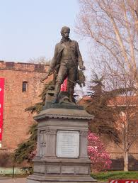
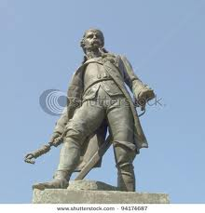
Famous Person
Pietro Micca (Born March 6, 1677 Died August 30, 1709 He was 32 years old) He was miner, The french army entered the underground galleries of the Citadel and killing the sentries protecting it and try to knock down the door leading to the galleries Pietro sacrifice his life to save underground galleries by he said to his "Stand up, go and save yourself because you are longer than a day without bread"

Slide 5
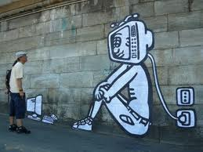
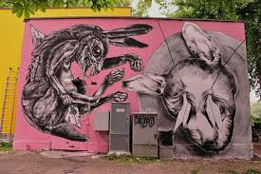
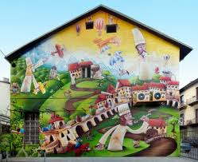
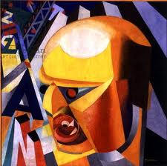
Art
Turin is famous for its art and it is highly respected. The streets are crammed of artists and their arts.

Slide 6
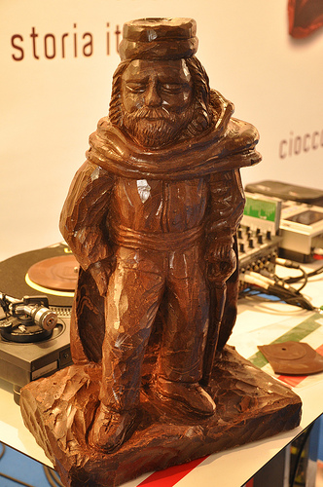
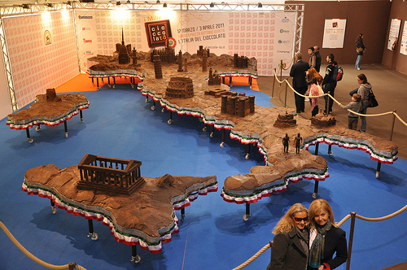
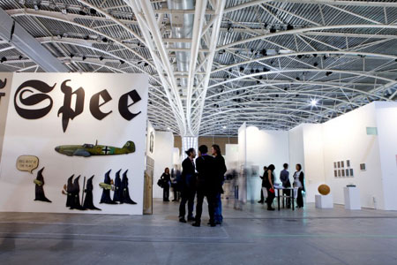
Festivals
Chocolate Festival- You have to buy a chocopass to get in. It began in 1861 and chocolates are made into monuments.
Artissima International Fair of Contemporary Art- It’s mostly for Trending Artists or new Artist that want to show their work to people

Slide 7
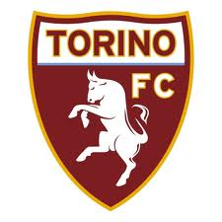
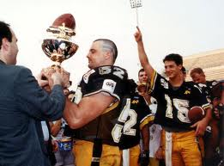
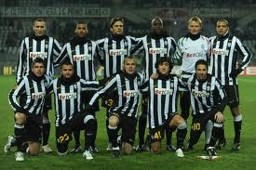
Sports
Soccer: Juventus and Torino FC
Basketball: PMS
American Football: Giaguari
Baseball Team: Akadema

